Slide 1
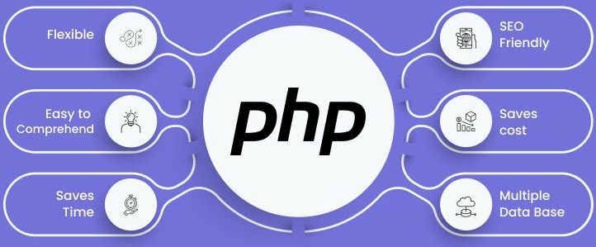

Slide 2
About today…
Security
Best Practices

Slide 4

Intro to Security Best Practices
Importance
Web data formats are structures that encode information to be easily
Protect sensitive data from unauthorized access and breaches
Maintain user trust and compliance with regulations (GDPR, HIPAA)
Common Security Threats
SQL Injection
Cross-Site Scripting (XSS)
Cross-Site Request Forgery (CSRF)
Data Breaches

Slide 5
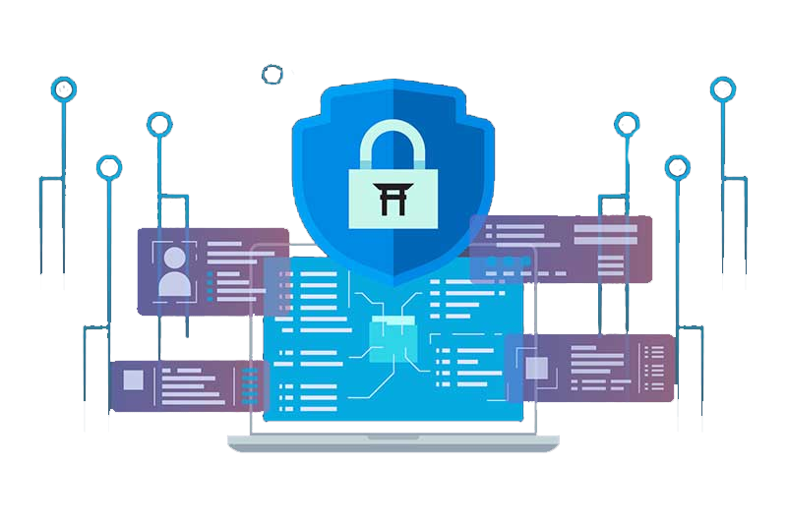
Secure Coding Practices
Follow Coding Standards
Adhere to well-known standards like PSR for PHP
Regular code reviews to ensure compliance
Minimize Use of Unsafe Functions
Avoid using deprecated functions
Prefer safer alternatives (e.g., mysqli over mysql)
Regular Code Refactoring
Continuously improve code quality
Identify and fix potential vulnerabilities

Slide 6
Input Validation and Sanitization
Validate and Sanitize Inputs
Ensure inputs conform to expected formats (e.g., email, dates)
Use built-in PHP functions like filter_var
Server-Side Validation
Client-side validation can be bypassed
Always validate data on the server
Prevent SQL Injection and XSS
Use prepared statements and parameterized queries
Escape HTML output to prevent XSS

Slide 7


Example
Preparing and Executing SQL Queries
How to securely query a database using PHP's PDO (PHP Data Objects)
$pdo->prepare()
Prepares an SQL statement with placeholders (:email) to prevent SQL injection attacks
$stmt->execute()
Executes the prepared statement, binding the actual value ($email) to the placeholder
Preventing XSS (Cross-Site Scripting)
How to safely handle user input to avoid XSS attacks
htmlspecialchars()
Converts special characters (like <, >, &, and ") in user input to HTML entities

Slide 8
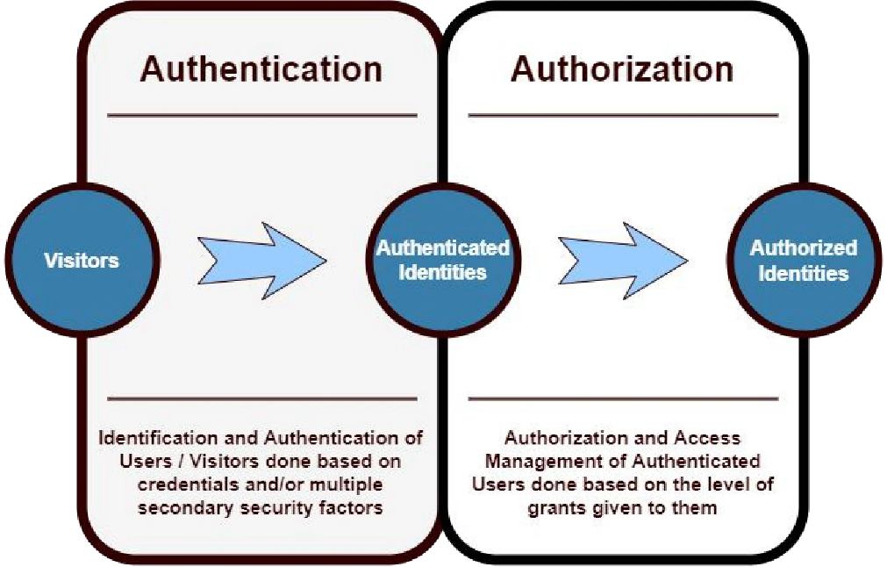
Authentication & Authorization
Strong Authentication Mechanisms
Use libraries like password_hash and password_verify
Implement OAuth for third-party logins
Multi-Factor Authentication (MFA)
Add an extra layer of security with SMS/email codes or authenticator apps
User Roles and Permissions
Define roles (admin, user, guest) with specific permissions
Enforce least privilege principle

Slide 9

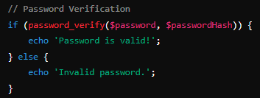
Secure Password Storage
Hashing Algorithms
Use bcrypt or Argon2 for hashing passwords
Avoid MD5 or SHA1 due to vulnerabilities
Salting Passwords
Add unique salt to each password before
hashing to prevent rainbow table attacks
Password Policies
Enforce strong password requirements (length, complexity)
Implement periodic password changes

Slide 10
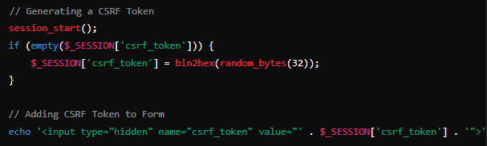
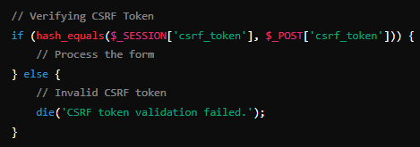
Protecting Against CSRF
CSRF Tokens
Generate unique tokens for forms and sensitive actions
Validate tokens on the server before processing requests
Form and URL Tokens
Embed tokens in forms and URLs for state-changing requests
Code Example
Verify tokens to prevent unauthorized actions

Slide 11
Keeping Software Updated
Regular Updates
Update your application, libraries, and dependencies regularly
Stay informed about new vulnerabilities and patches
Security Patches
Apply security patches as soon as they are released
Test updates in a staging environment before production deployment
Monitoring Advisories
Subscribe to security advisory feeds for your tech stack
Monitor for critical updates and vulnerabilities

Slide 12
Backup and Recovery
Regular Backups
Schedule regular backups of critical data
Store backups securely, preferably offsite
Disaster Recovery Plan
Develop and document a disaster recovery plan
Include steps for data recovery and service restoration
Testing Backup Processes
Regularly test backup and recovery processes
Monitor for critical updates and vulnerabilities

Slide 13
Security Awareness Training
Educate Team
Conduct regular training sessions on security best practices
Keep team members informed about emerging threats
Promote Security Culture
Encourage a security-first mindset across the organization
Reward proactive security behavior
Ongoing Education
Provide access to security resources and courses
Stay updated with the latest

Slide 14


Slide 15

What is the purpose of using HTTPS in web communication?
Encrypts data in transit to protect it from being intercepted and read by
unauthorized parties
What is a CSRF token and why is it used?
unique value used to prevent unauthorized actions on behalf of a user by verifying that requests come from a legitimate source.
Which hashing algorithm is recommended for securely storing passwords?
bcrypt is recommended for securely hashing passwords due to its adaptive nature and resistance to brute-force attacks
How can you prevent SQL injection in PHP?
Use prepared statements and parameterized queries with PDO or MySQLi to prevent SQL injection attacks

Slide 16

Task 1
Build a simple login system with secure authentication and password handling

